Slide 1
www.climate-diamond.eu
Project Overview
Delivering the next generation of open Integrated Assessment MΟdels for Net-zero, sustainable Development
ATHENS KICK-OFF MEETING (KOM) 8-9 SEPTEMBER 2022
Dr. Alexandros Nikas, Prof. Haris Doukas (NTUA)

Slide 2
Overview
Title:​ | Delivering the next generation of open Integrated Assessment MOdels for Net-zero, sustainable Development (DIAMOND)
Funding:​ | European Union’s Horizon Europe Research and Innovation Programme (HE)​
Lifetime:​ | December 2022 – November 2026 (48 months)​
Coordination:​ | Energy Policy Unit, Institute of Communications and Computer Systems (ICSS)
Participants:​ | 13 beneficiaries, 6 associated partners
Call/Grant:​ | HORIZON-CL5-2022-D1-02-03/101081179​

Slide 3
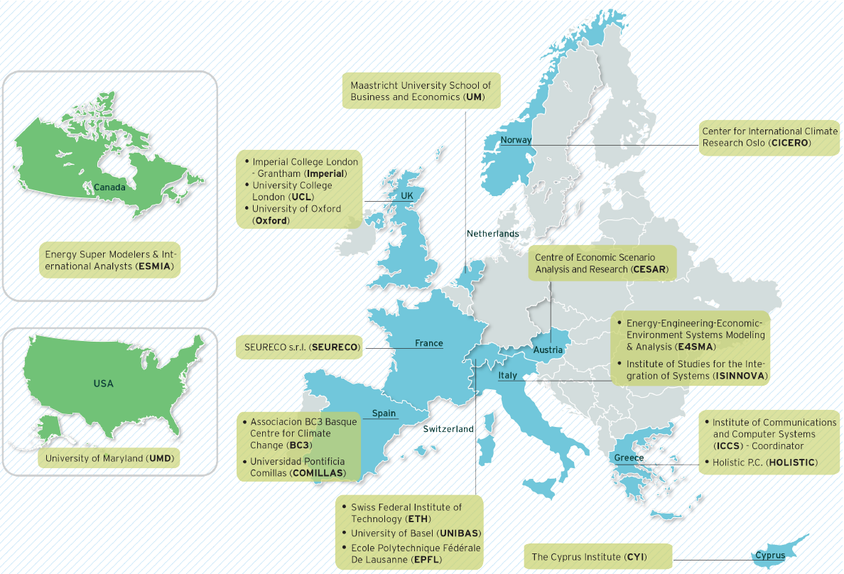
Consortium

Slide 4
Objectives
O₁.​ | Go beyond the state-of-the-art of six leading IAMs (increase detail, resolution & capacity)
O₂.​ | Enhance the capabilities of IAMs (SDGs interaction, political & behavioural aspects)
O₃.​ | Create robust, fully integrated assessment frameworks​
O₄.​ | Expand the scenario space and uncertainty spectrum ​
O₅.​ | Open all modelling enhancements
O₆.​ | Develop a transdisciplinary scientific approach to co-create the research questions
O₁.​ | Go beyond the state-of-the-art of six leading IAMs (increase detail, resolution & capacity)
O₂.​ | Enhance the capabilities of IAMs (SDGs interaction, political & behavioural aspects)

Slide 5
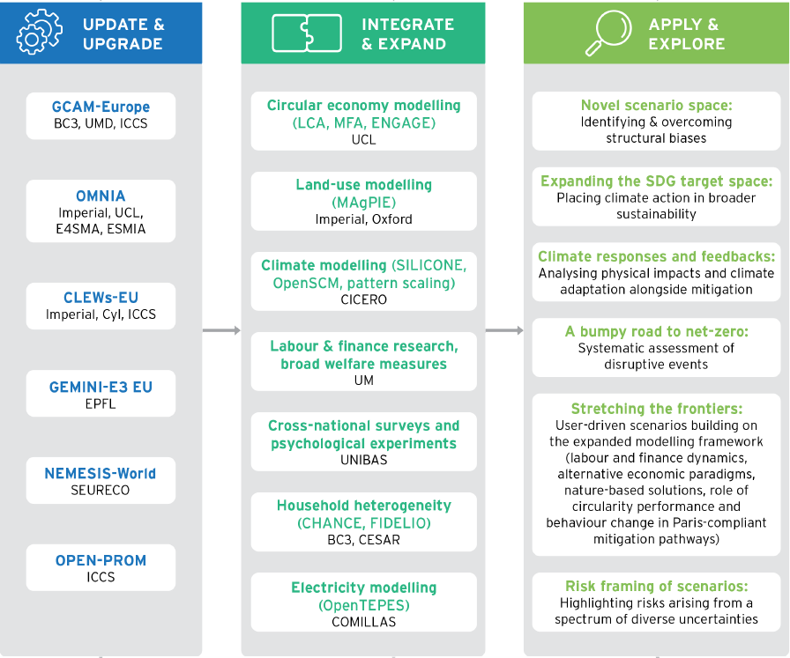
Methodology & Structure

Slide 6
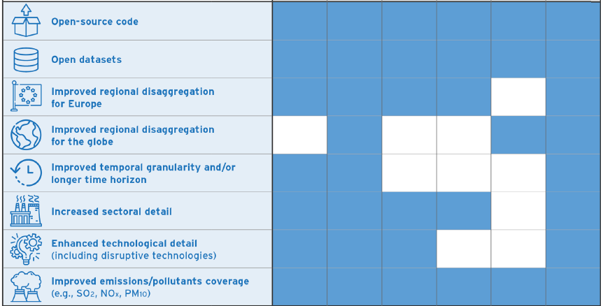
IAM enhancements
IAM Enhancements (WP3)

Slide 7
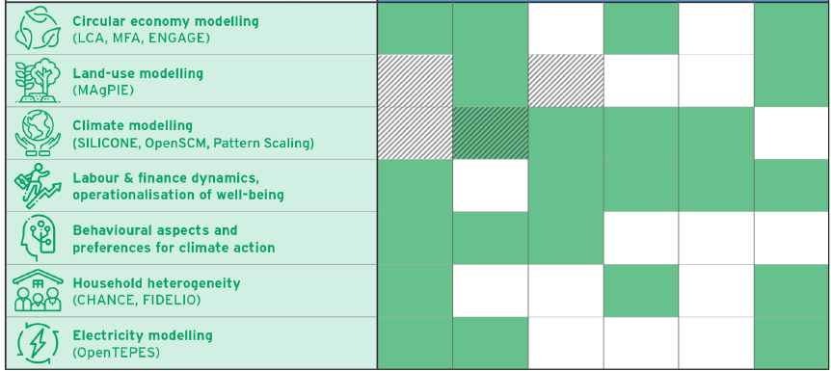
Model interlinkages
Model Interlinkages (WP4)

Slide 8
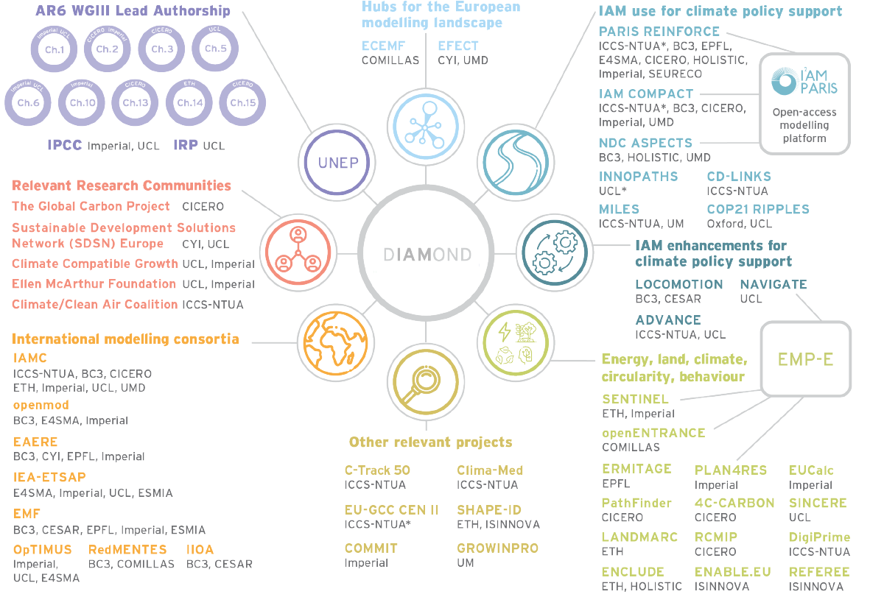
Moving Science Forward

Slide 10
Alexandros Nikas
anikas@epu.ntua.gr
Haris Doukas
h_doukas@epu.ntua.gr
climatediamond
climatediamond
climatediamond

